Slide 1
Predicting the Disulfide Bonding State of Cysteines with Combinations of Kernel Machines
ALESSIO CERONI, PAOLO FRASCONI , ANDREA PASSERINI AND ALESSANDRO VULLO
Journal of VLSI Signal Processing 35, 287–295, 2003
Presenter : Chih-Ying Lin
Date : Sept. 04, 2009

Slide 2
Abstract
Cysteines may form covalent bonds, known as disulfide bridges, that have an important role in stabilizing the native conformation of proteins. Several methods have been proposed for predicting the bonding state of cysteines, either using local context or using global protein descriptors. In this paper we introduce an SVM based predictor that operates in two stages. The first stage is a multi-class classifier that operates at the protein level, using either standard Gaussian or spectrum kernels. The second stage is a binary classifier that refines the prediction by exploiting local context enriched with evolutionary information in the form of multiple alignment profiles. At both stages, we enriched profile encoding with information about cysteine conservation. The prediction accuracy of the system is 85% measured by 5-fold cross validation, on a set of 716 proteins from the September 2001 PDB Select dataset.

Slide 3


Input encoding
D_{i}
log(N_{i} ^{j}/N ^{j} )
log(N_{i} /N_{avg})
flag indicating whether the cysteine count is odd.

Slide 4
Cysteines conservation
extended alphabet having 19+ Z symbols, where occurrences of C (cysteine) are replaced by a special symbol that indicates the degree of conservation of the cysteines in the correspondent positions of multiple alignments.
Ex:Z=5
Use c₁,c₂,c₃,c₄,c₅
kkrlq c₁atltqtd c₃nedwa c₂qgrke
c c _
c _ c
c _ c
c c c

Slide 5
Input encoding
W_{t}^{k}
log(N_{i} ^{j}/N ^{j} )
relative entropy
conservation weight

Slide 6

Relative entropy
ccc c_c cah __c cc_
-(3/9)log(3/9) - (2/9)log(2/9) - (1/9)log(1/9) - (2/9)log(2/9)
= 0.159+0.145+0.106+0.145
=0.555

Slide 7
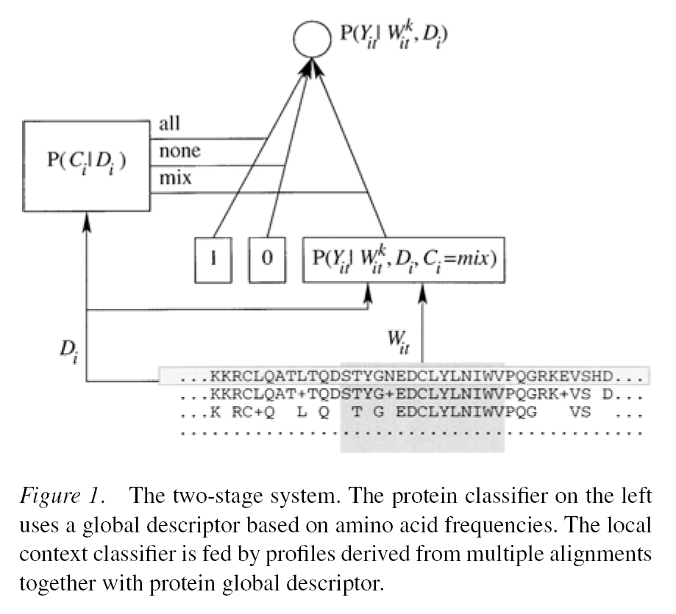
The two-stage system.

Slide 8
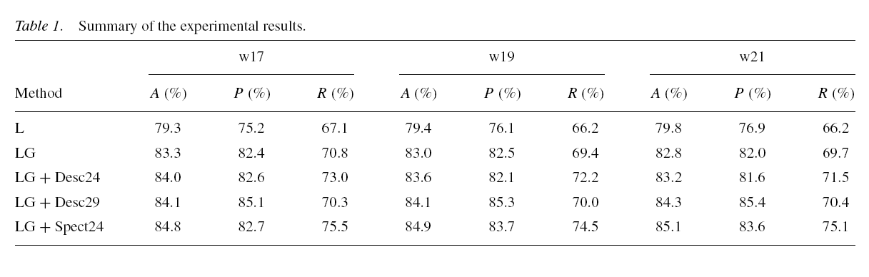
Results
Precision (or sensitivity) is the fraction of cysteines
predicted in the disulﬁde-bonded state that are actually
bonded.
Recall (or speciﬁcity) is the fraction of disulﬁde-bonded
cysteines that are correctly assigned to their state by
the predictor.
716 proteins dataset
187 of type all,
478 of type none,
51 of type mix (i.e. only 7%)

